Slide 1
Metaphor in Grammar: Conceptualization of Time
Laura A. Janda
University of Tromsø

Slide 2
Overview
Matter provides the source domain for the metaphor that motivates aspect in Russian
PERFECTIVE IS A DISCRETE SOLID OBJECT vs. IMPERFECTIVE IS A FLUID SUBSTANCE
Correlation between aspectual distinctions and count/mass, number distinctions

Slide 3
Slavic Aspect:
Contrasts perfective vs. imperfective (no progressive and no neutral aspect)
Is independent of tense and other verbal categories
Implements imperfective (as unmarked) where other languages would have perfective
Has a complex and seemingly incoherent array of uses

Slide 4

Traditional Feature Analyses
Boundedness, Totality, Definiteness, Change vs. Stability, Sequencing vs. Simultaneity, Exterior vs. Interior, Figure vs. Ground, Punctuality vs. Durativity, Resultative
Lack intricacy needed to account for uses
Are ultimately new synonyms for perfective vs. imperfective

Slide 5
The ICM of Matter
Conflates notions of count vs. mass, solid vs. fluid, hard vs. soft, shaped vs. formless, etc.
Both more narrow and more richly textured than count vs. mass (basic level)
Russian has made a heavy morphological investment in nominal distinctions relating to this ICM (individuation)

Slide 6
The Two Types of Matter
Discrete Solid Object:
  Nut
  Apple
  Chair
  Pail
  Truck
Fluid substance:
  Sand
  Water
  Air
  Smoke

Slide 7


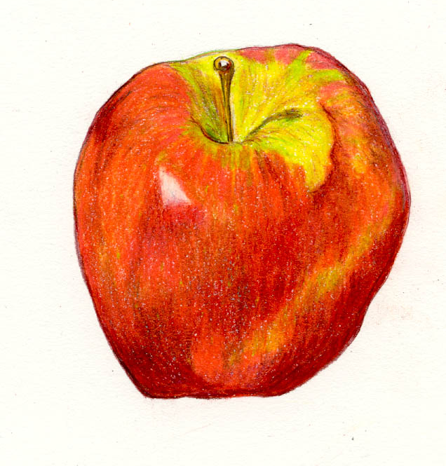
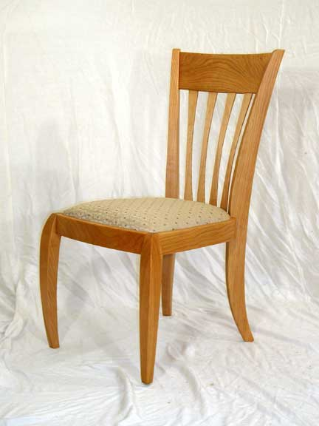

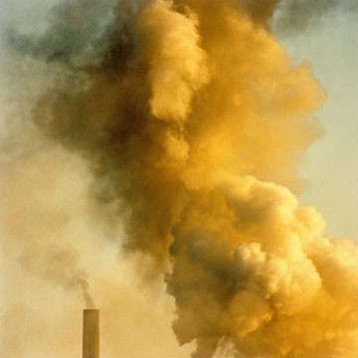
The Two Types of Matter
Discrete Solid Object:
Fluid substance:

Slide 8
Temporal Metaphors from General to Specific:
TIME IS SPACE (well-documented, cf. Haspelmath 1997)
A SITUATION IS A MATERIAL ENTITY (cf. comparisons of perfective vs. imperfective to count vs. mass)
PERFECTIVE IS A DISCRETE SOLID OBJECT vs. IMPERFECTIVE IS A FLUID SUBSTANCE

Slide 9
Russian Investments in Individuation
Number is overt, obligatory, intricate, and marked on all inflected words as sg or pl (no default general number)
Russian categorizes as masses items that other languages categorize as individuals (fruits, ethnonyms)
Collective and singulative suffixes
Genitive/Locative singular –u for mass nouns

Slide 10
Parallels between Russian Nominal and Verbal Morphology
Perfective vs. Imperfective is obligatory and ubiquitous like sg vs. pl
Semelfactive -nu- parallels singulative -in(k)-a
Imperfectivizing suffixes parallel collective suffixes (cf. –stvo in učitel’stvo)
Delimitatives in po- parallel quantification of masses

Slide 11
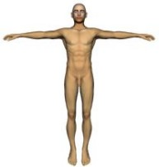
The Human Observer
NOW is a point in the timeline, but it is occupied by a human observer
The Human Observer is not a point, and interacts with situations the way that a discrete solid interacts with material entities
This is important for distinguishing future time from present time, and for gnomic vs. non-gnomic

Slide 12
Properties of Matter and Parameters of Aspect
Inherent Properties -- correspond to inherent structure of situations and act as default values
Interactional Properties -- correspond to discourse structure, and can override Inherent Properties
Human Interactional Properties -- correspond to pragmatic structure, and can override Inherent Properties

Slide 13
Analysis of Russian Aspect
See the Table and the examples in your handout.
The letters on the Table correspond to the lettered headings of the examples.
The numbers correspond to the numbered examples on the handout.

Slide 14
A. - G.: Properties inherent to types of matter
A. Edges
B. Shape
C. Integrity
D. Countability
E. Streamability
F. Penetrability
G. Conversions

Slide 15
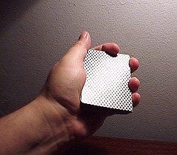

A. Edges
Perfective:
  Has edges 1)
Imperfective
  Has no edges 2)

Slide 16
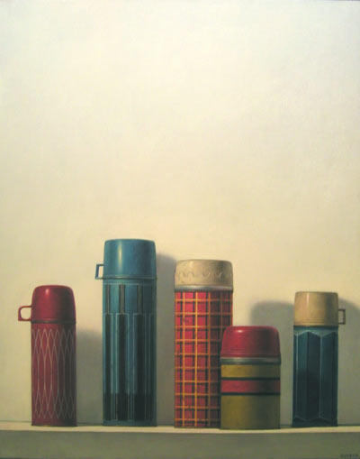
B. Shape
Perfective
  Can have various shapes 3), 4), 5)
Imperfective
  Has no shape but can spread 6), 7), 8), 9)

Slide 17

C. Integrity
Perfective:
  A unique occurrence 10)
Imperfective:
  Continuous processes and repetitions 11), 12)

Slide 18
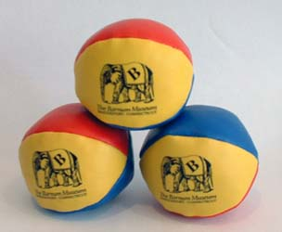
D. Countability
Perfective:
  Quantified 13), 14)
Imperfective:
  Not inherently quantified, can fill 15), 16), 17)

Slide 19
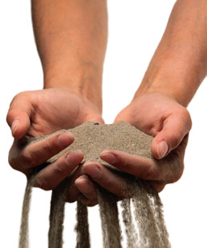
E. Streamability
Perfective:
  Gestalt 18)
Imperfective:
  Gradual accumulation 19), determined motion verbs

Slide 20

F. Penetrability
Perfective:
Imperfective: Internal descriptions 20)

Slide 21
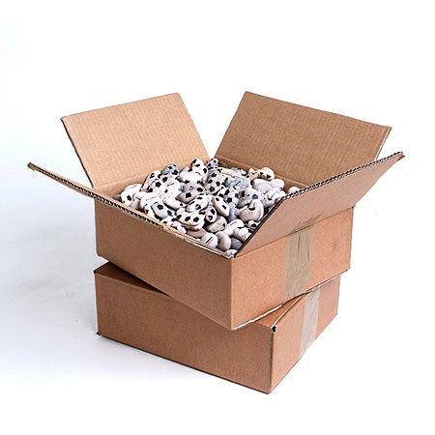
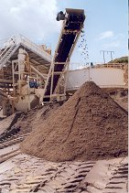

G. Conversions
Perfective:
  –nu- singularization, packaging (23)
Imperfective:
  pulverization & piling of repetition 21), 22)

Slide 22
H. – K.: Interactions of types of matter and discourse structure
H. Compatibility
I. Dynamicity
J. Salience
K. Contiguity

Slide 23
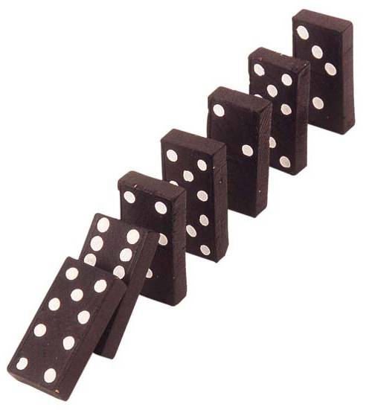

H. Compatibility
Perfective: Sequencing and future 24), 25), 26)
Imperfective:
Simultaneity and present 27), 28), 29), 30)

Slide 24

H. Compatibility, cont’d.
Perfective embedded in imperfective:
  Interruption of ongoing action 31)

Slide 25
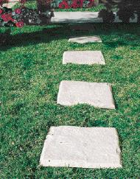

I. Dynamicity
Perfective: moves story along 32)
Imperfective slows story down 32)

Slide 26
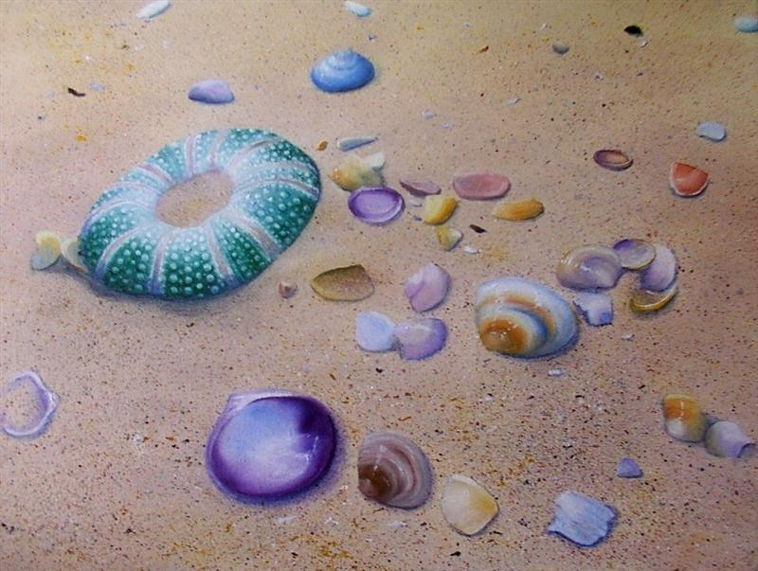
J. Salience
Perfective: obvious, foregrounded events 32)
Imperfective: backgrounded events 32), 33)

Slide 27
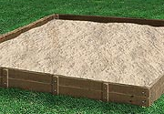
K. Contiguity
Combination of perfective edges with imperfective masses 34), 35), 36)

Slide 28
L. – N.: Interactions of humans with types of matter and pragmatic structure
L. Stability
M. Texture
N. Implied conversions

Slide 29

L. Stability
Perfective: satisfying stability 37), 38), 39)
Imperfective: nothing to grab onto 40), 41)

Slide 30
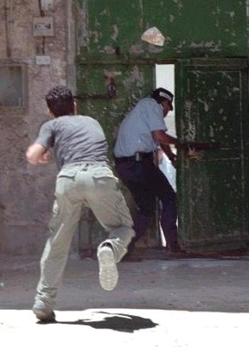

M. Texture
Perfective: forceful 42)
Imperfective: Generalized 43) and polite

Slide 31
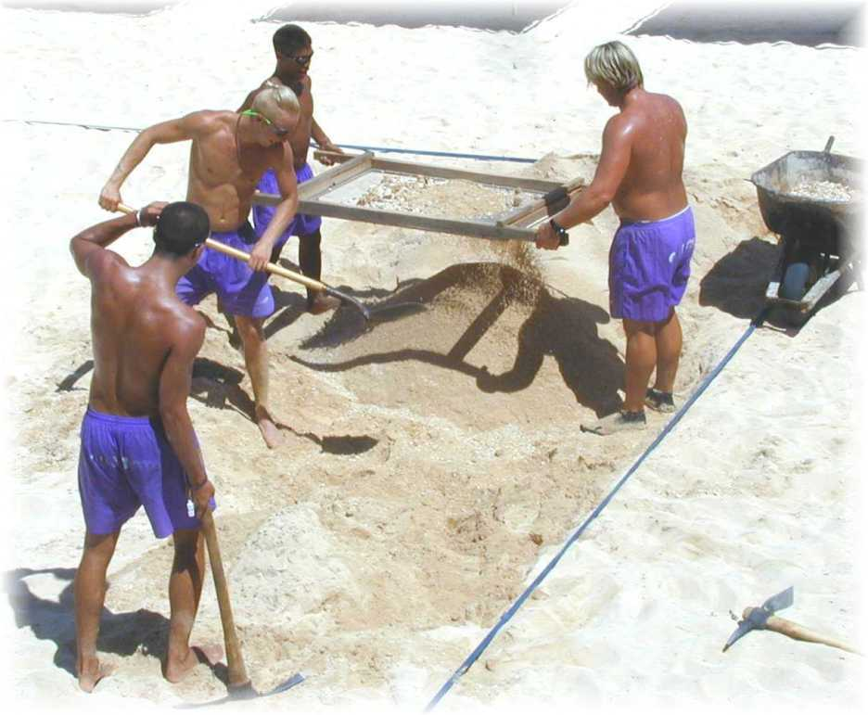
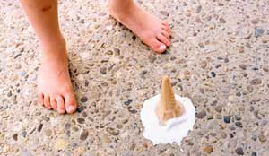
N. Implied conversions
Perfective: Trying and succeeding 44)
Imperfective: Previous result no longer there 45)

Slide 32
Beyond Slavic
French: more perfective than imperfective; motivated more by closed vs. open or discrete vs. filling; attenuated number
Chinese: perfective, imperfective and neutral aspect, probably motivated from various sources; reduced number and no formal count vs. mass distinction
Navajo: Similar to Chinese, and with no number distinction

Slide 33
How did this system evolve?
In 2011-2012 we will have our research group at the Academy of Sciences in Oslo
We will focus on:
  The evolution of concepts of time
  Relation of linguistic concepts to concepts in other domains (science, belief, art)

